Slide 1


Introduction to Cybersecurity
Cryptography
ILIA STATE UNIVERSITY
Paata Gogishvili
Doctor of Informatics
Associate Professor
School of Technology
March 13, 2023
Faculty of Business, Technology and Education

Slide 2
Lecture Topics
Meaning and importance of Cryptography
Symmetric encryption VS asymmetric encryption
Attacks on cryptography algorithms
ILIA STATE UNIVERSITY

Slide 3
Meaning and importance of cryptography
Cryptography is the science of securing communication and information through the use of codes and ciphers.
Its importance has increased in recent years, as the world becomes more and more digital, and sensitive information is transmitted across networks.
Cryptography ensures that only the intended recipient can read a message or access data, by encoding it in such a way that it is unreadable to anyone else. It also helps to ensure that messages and data have not been tampered with or altered in transit, by providing mechanisms for detecting such changes.
ILIA STATE UNIVERSITY

Slide 4
Main Instruments
Cryptography uses a variety of instruments or techniques to achieve its goals of ensuring confidentiality, integrity, and authenticity of information. Some of the main instruments used in cryptography include:
Encryption
Decryption
Hash Functions
Digital Signatures
Public Key Cryptography
Symmetric Key Cryptography
Steganography
These are just some of the main instruments used in cryptography. There are many other techniques and algorithms that are used to provide secure communication and protect sensitive information.
ILIA STATE UNIVERSITY

Slide 5
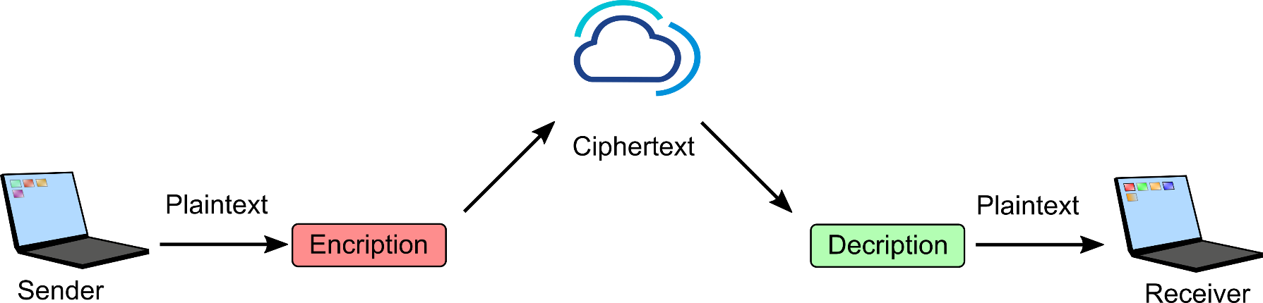
Encryption
Encryption is the process of transforming information in such a way that it becomes unreadable to anyone who does not have the key or password to decrypt it. This ensures that the information remains confidential and only accessible to authorized users.
Decryption
Decryption is the process of reversing encryption to reveal the original information. This is done using a secret key or password that only the authorized recipient possesses.
ILIA STATE UNIVERSITY

Slide 6
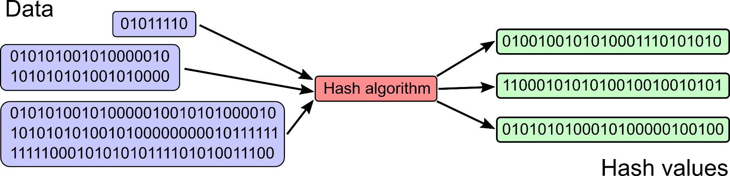
Hash Function
A hash function is a mathematical algorithm that takes a message or data input and produces a fixed-size output, called a hash value.
Hash functions are used to ensure the integrity of data by detecting any changes to the data during transmission or storage.
Even small change in the message leads to completely different hash function.
ILIA STATE UNIVERSITY

Slide 7
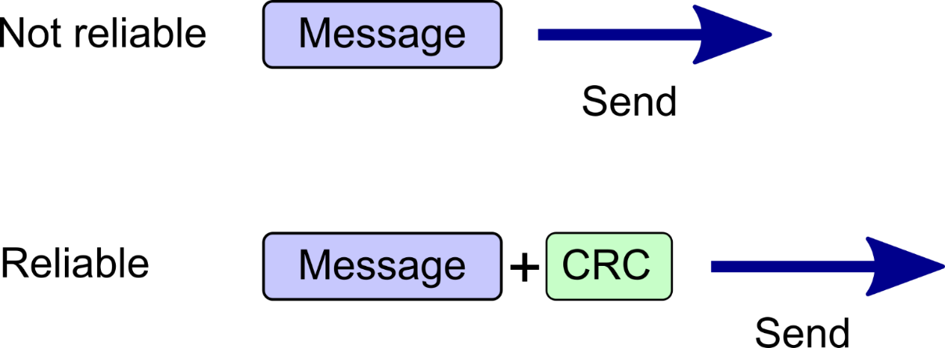
Cyclic Redundancy Check (CRC)
ILIA STATE UNIVERSITY

Slide 8
Hash calculation tools
If we have agreement.pdf file and want to calculate SHA256 hash function for it’s content, we can use the following command in windows cmd: certUtil -hashfile agreement.pdf SHA256
Hash value can be calculated via bunch of online tools also:
https://www.browserling.com/tools/all-hashes
Here is the python code for hash calculation:
import hashlib
my_string = "Hello, world!"
hash_object = hashlib.sha256(my_string.encode())
hash_value = hash_object.hexdigest()
print(hash_value)
ILIA STATE UNIVERSITY

Slide 9
Security aspects of older algorithms
Note that some older hash algorithms, such as MD2 and MD4, may not be recommended for use in modern applications due to known vulnerabilities. It's generally a good idea to use one of the SHA hash functions for secure hashing.
MD2 was developed by Ronald Rivest in the late 1980s. It was widely used in the 1990s and early 2000s, but it is now considered insecure due to several vulnerabilities that have been discovered over the years.
One of the main vulnerabilities of MD2 is its susceptibility to collision attacks. A collision attack is a type of attack where an attacker tries to find two different messages that produce the same hash value. In the case of MD2, it is possible to find two different messages that have the same hash value with relatively little computational effort.
ILIA STATE UNIVERSITY

Slide 10
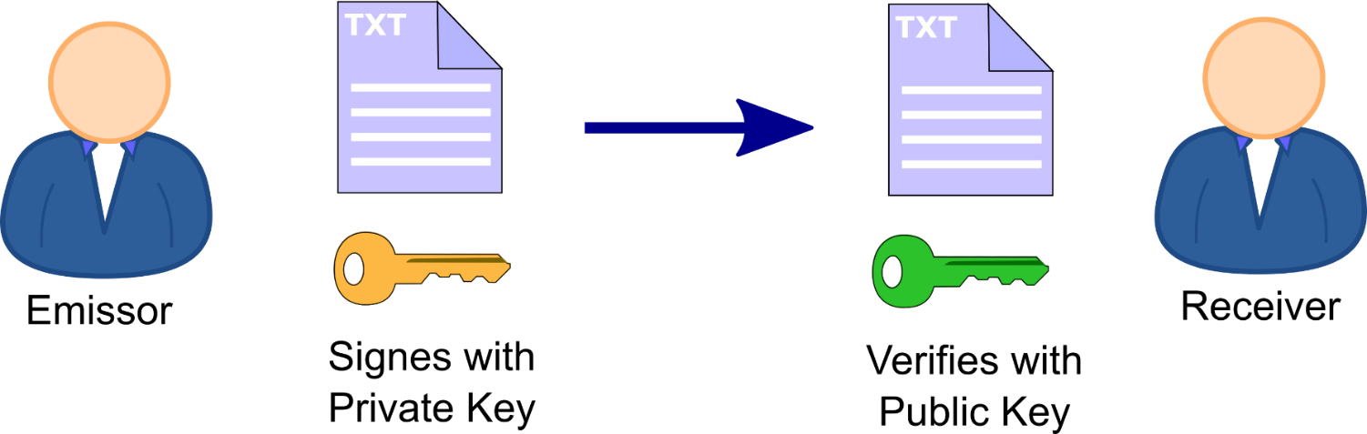
Digital Signature
Digital signatures are used to provide authentication and non-repudiation of electronic documents or messages. They are created using a combination of a private key and a hash function, and can only be verified using the corresponding public key.
ILIA STATE UNIVERSITY

Slide 11



Georgian ID card
We can sign documents digitally via Georgian ID card.
ID card, Card reader and Software are needed to sign PDF documents.
ILIA STATE UNIVERSITY
http://id.ge

Slide 12
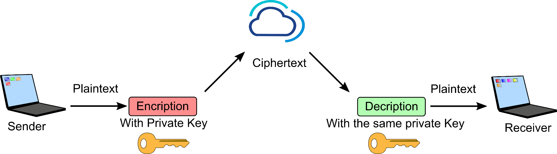
Symmetric encryption
Symmetric key cryptography, also known as secret key cryptography, uses a single key to both encrypt and decrypt information. This key must be kept secret and shared only between the authorized parties.
ILIA STATE UNIVERSITY

Slide 13
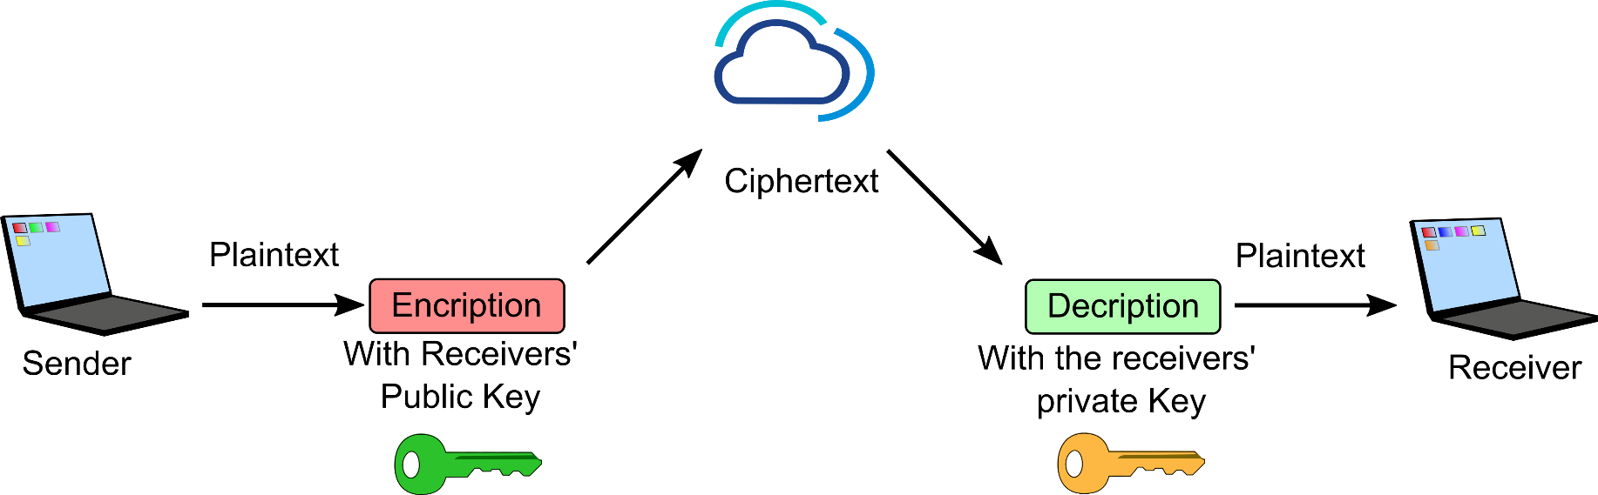
Asymmetric cryptography
Asymmetric cryptography, also known as public key cryptography, uses a pair of keys – a public key and a private key – to encrypt and decrypt information. The public key is shared with anyone who wants to send a message, while the private key is kept secret and used by the intended recipient to decrypt the message.
ILIA STATE UNIVERSITY

Slide 14
Steganography
Steganography is the practice of concealing a message, file, or other information within another object or message in a way that the presence of the hidden information is not apparent. It is often used to protect sensitive data or to secretly communicate messages.
The word steganography comes from the Greek words "steganos," meaning "covered," and "graphia," meaning "writing." The practice of steganography dates back to ancient times, where people used various techniques to hide messages within objects such as wax tablets or tattoos on shaved heads.
In modern times, steganography is often used in digital media, such as images, audio files, and videos. For example, one common technique is to embed a message within the least significant bits of an image or audio file. This technique is often used to hide copyright information or to secretly communicate information.
ILIA STATE UNIVERSITY

